Slide 1

An introduction to statistical inference
Dr. Abhay Pratap Pandey
University of Delhi

Slide 2

What is inference?
Inference defined:
An everyday meaning…
We infer a conclusion based on evidence and reasoning
A statistical meaning…
We infer a property of a population from a sample

Slide 3
Why inference?
The aim of inference is to determine the characteristics of a population from a sample.
Population
Sample

Slide 4
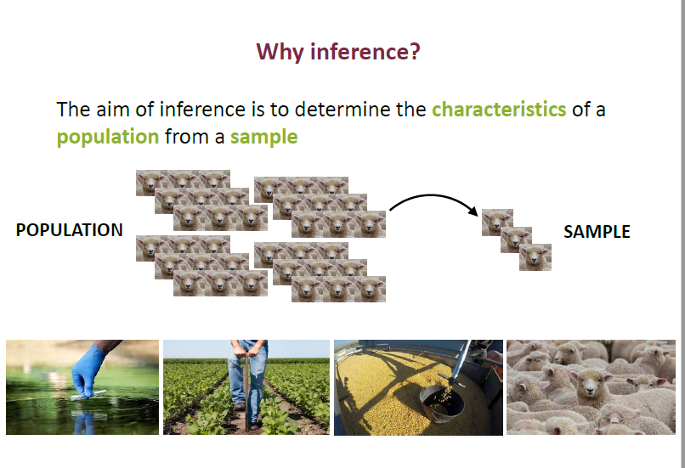

Slide 5
Population and sample
In statistical analysis, a population is a collection of all the people, items, or events about which one wants to make inferences. OR
Any well-defined group of subjects, which could be individuals, firms, cities, or many other possibilities
(For example university students in India.)
In statistical analysis, a sample, is a subset of the population (i.e. the people, items, or events) that one collects and analyzes to make inferences. (For example 200 randomly chosen university students.)

Slide 6
Statistical sample - Subset of the population chosen to represent the population in a statistical analysis; denoted as (X1,X2, ... Xn).
Random sample- randomly chosen from the population sample of individuals.
In the case of random sampling, the following techniques can be used:
Independent sampling (draw with replacement) - after each draw the unit returns to the population.
Dependent sampling (draw without replacement) - after each draw the unit does not return to the population (no longer participate in the drawing).
In statistical analysis, an observation is an elements of the sample. (For example Helena, a student at Central University.)

Slide 7
Statistical inference
Sampling
Testing of hypothesis
Estimation

Slide 8
Aim of statistical inference
The aim of statistical inference is to learn about the population using the observed data
This involves:
computing something with the data
a statistic: function of data
interpret the result
in probabilistic terms: sampling distribution of statistic

Slide 9

Estimation
Determination of the population parameter by the calculation of a sample statistic…
Population
Parameter
μ
Sample
Statistic
$$\overline{x}$$
Characteristic

Slide 10
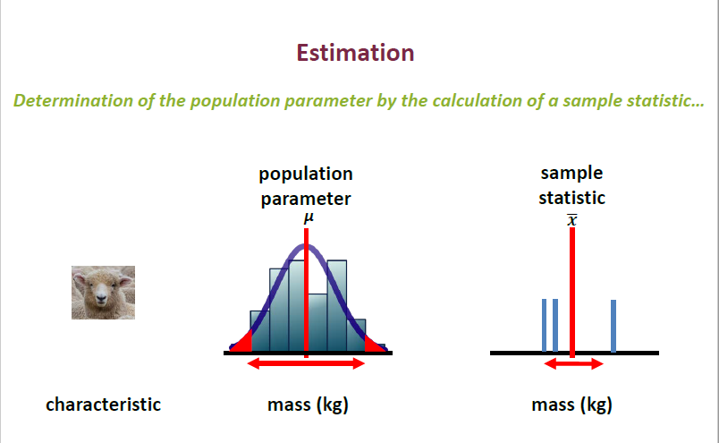

Slide 11
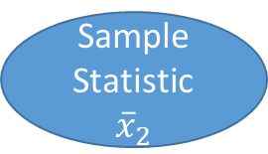
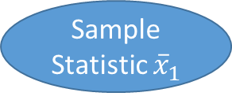

Uncertainty
A sampling distribution is a probability distribution of a statistic obtained through a large number of samples drawn from a specific population.
Sample
Statistic ${\overline{x}}_{1}$
Population parameter
μ
Sample
Statistic ${\overline{x}}_{2}$
Uncertainty
Estimates are not perfect
Sample
Statistic ${\overline{x}}_{3}$
Sampling
distribution

Slide 12
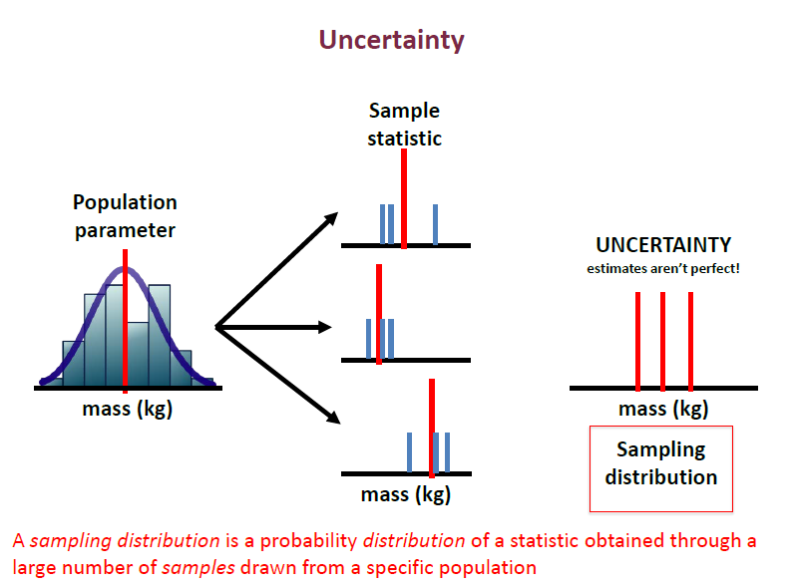

Slide 13
Types of estimators in statistics
Estimator
An estimator is a statistic (function of data) that produces such a guess.
We usually mean by “best” an estimator whose sampling distribution is more concentrated about the population parameter value compared to other estimators.
The two main types of estimators in statistics are
Point estimators
Interval estimators
Point estimation: Point estimators are functions that are used to find an approximate value of a population parameter from random samples of the population. They use the sample data of a population to calculate a point estimate or a statistic that serves as the best estimate of an unknown parameter of a population. We want to estimate a population parameter using the observed data.
Ex. some measure of variation, an average, min, max, quantile, etc.

Slide 14
Interval estimation
Interval estimation uses sample data to calculate the interval of the possible values of an unknown parameter of a population. The interval of the parameter is selected in a way that it falls within a 95% or higher probability, also known as the confidence interval. The confidence interval is used to indicate how reliable an estimate is, and it is calculated from the observed data. The endpoints of the intervals are referred to as the upper and lower confidence limits.

Slide 15
Properties of Point Estimators
Unbiasedness
Consistency
Sufficiency
Efficiency
Unbiasedness
An estimator of a given parameter is said to be unbiased if its expected value is equal to the true value of the parameter.
The bias of a point estimator is defined as the difference between the expected value of the estimator and the value of the parameter being estimated. When
Also, the closer the expected value of a parameter is to the value of the parameter being measured, the lesser the bias is.

Slide 16
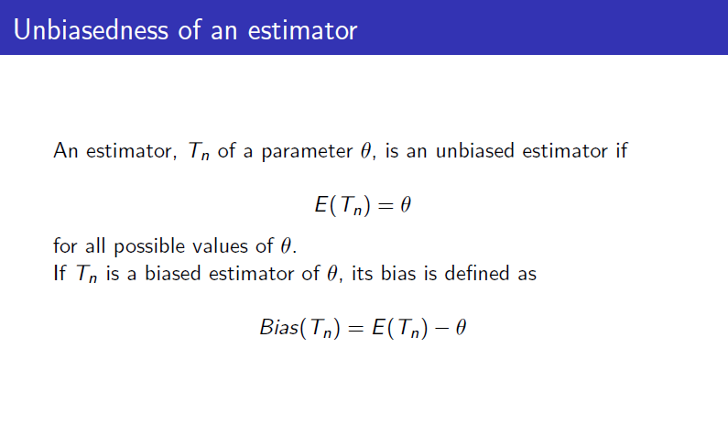

Slide 17
Consistency
Consistency tells us how close the point estimator stays to the value of the parameter as it increases in size. The point estimator requires a large sample size for it to be more consistent and accurate. You can also check if a point estimator is consistent by looking at its corresponding expected value and variance. For the point estimator to be consistent, the expected value should move toward the true value of the parameter.

Slide 18
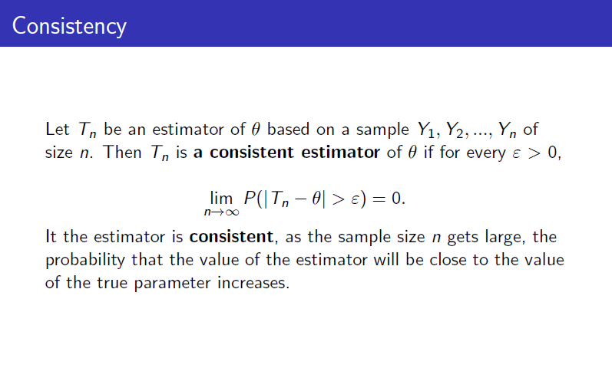

Slide 19
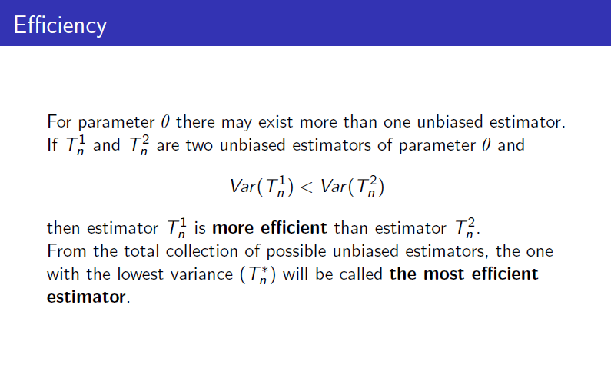

Slide 20
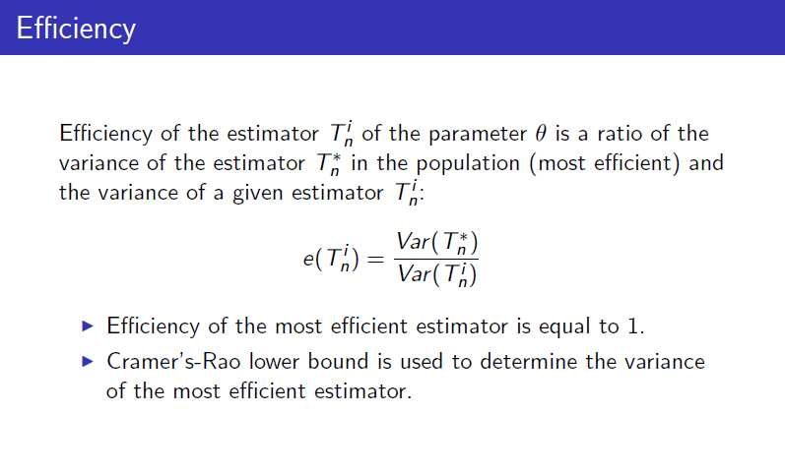

Slide 21
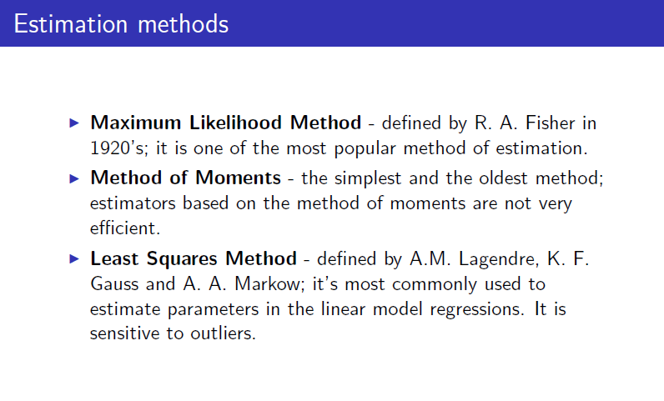

Slide 22
Maximum likelihood estimator
The maximum likelihood estimator method of point estimation attempts to find the unknown parameters that maximize the likelihood function. It takes a known model and uses the values to compare data sets and find the most suitable match for the data.
For example, a researcher may be interested in knowing the average weight of babies born prematurely. Since it would be impossible to measure all babies born prematurely in the population, the researcher can take a sample from one location. Since the weight of pre-term babies follows a normal distribution, the researcher can use the maximum likelihood estimator to find the average weight of the entire population of pre-term babies based on the sample data.

Slide 23
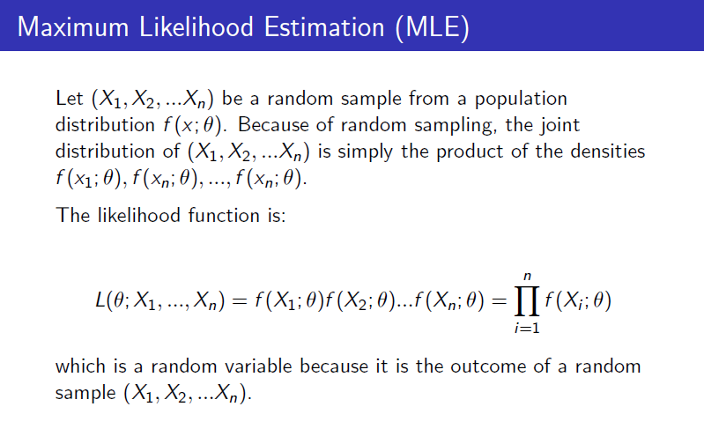

Slide 24
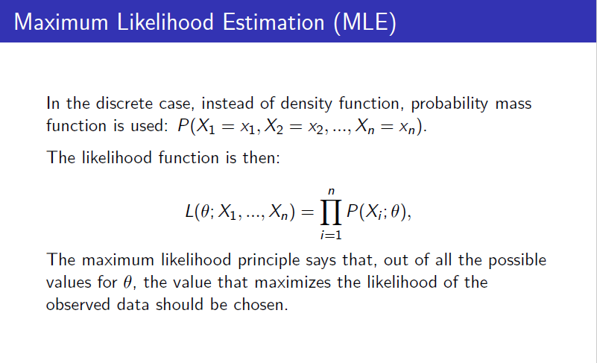

Slide 25
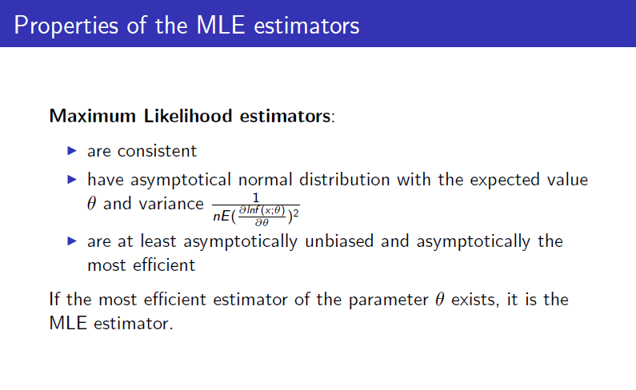

Slide 26
Method of moments
The method of moments of estimating parameters was introduced in 1887 by Russian mathematician Pafnuty Chebyshev. It starts by taking known facts about a population and then applying the facts to a sample of the population. The first step is to derive equations that relate the population moments to the unknown parameters.
The next step is to draw a sample of the population to be used to estimate the population moments. The equations derived in step one are then solved using the sample mean of the population moments. This produces the best estimate of the unknown population parameters.

Slide 27
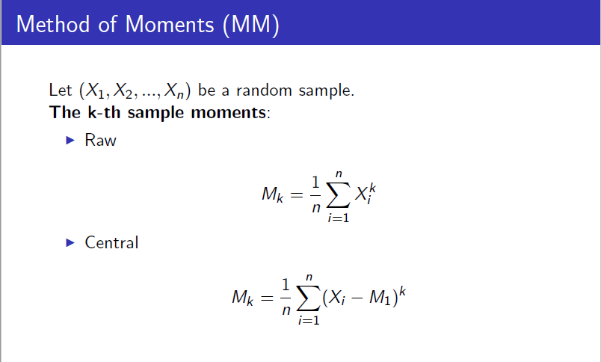

Slide 28
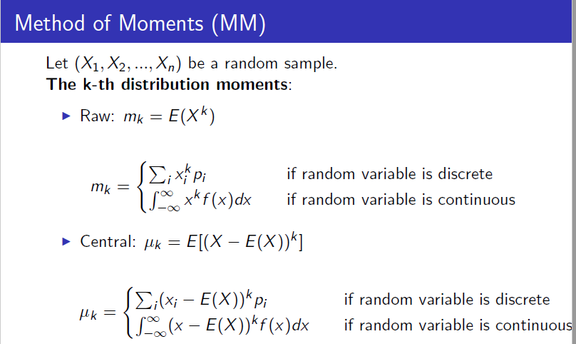

Slide 29
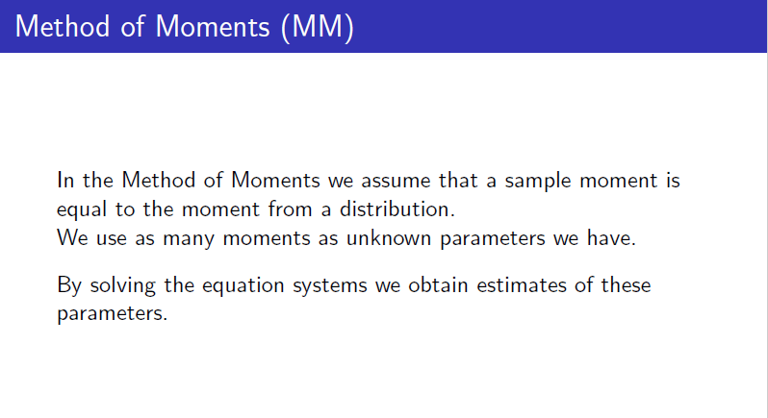

Slide 30
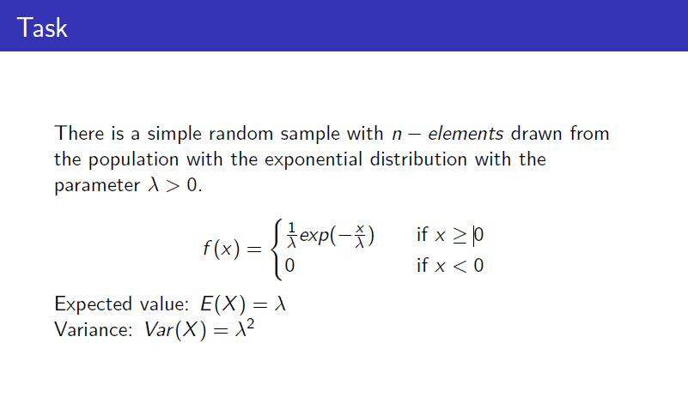

Slide 31
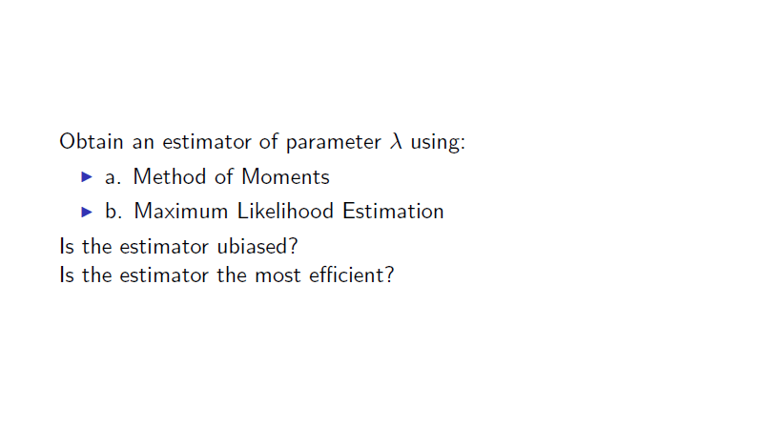

Slide 32
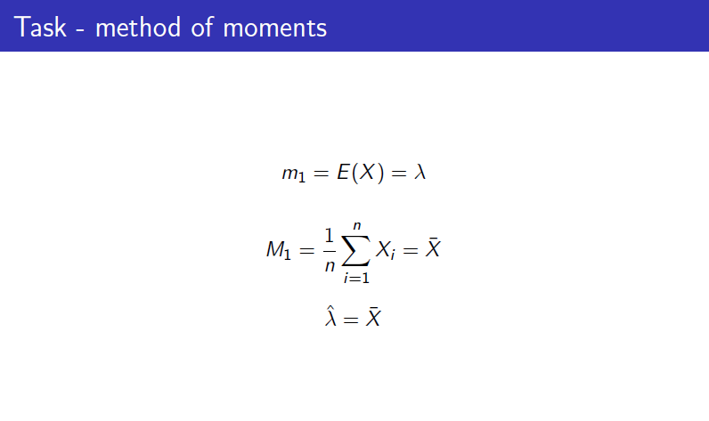

Slide 33
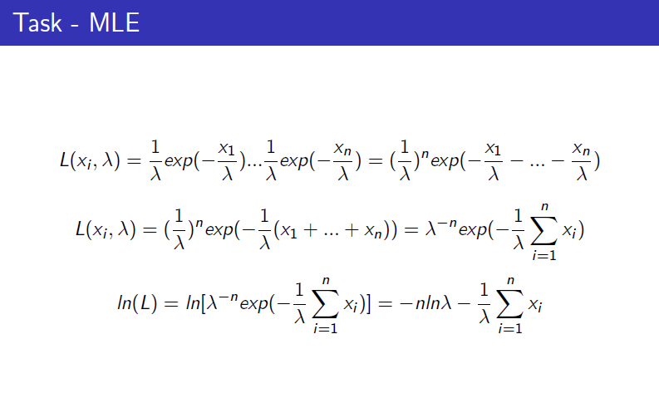

Slide 34
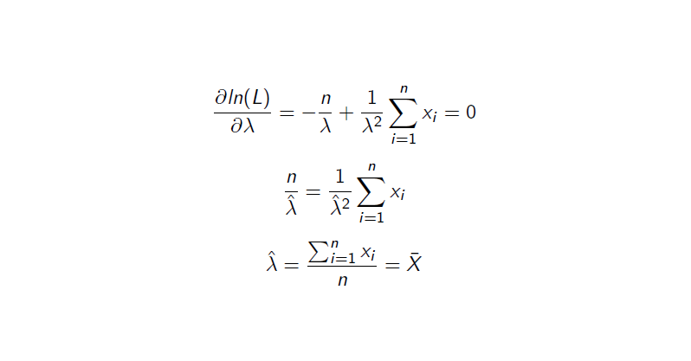

Slide 35
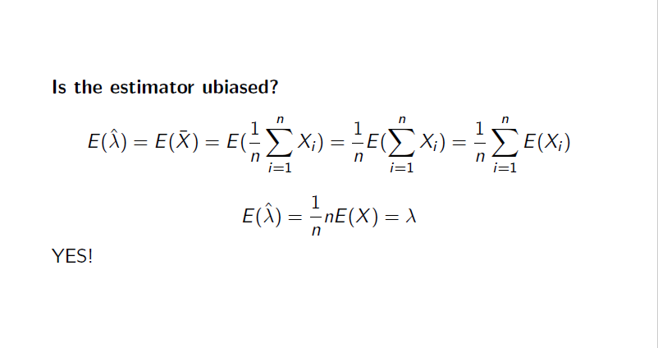

Slide 36
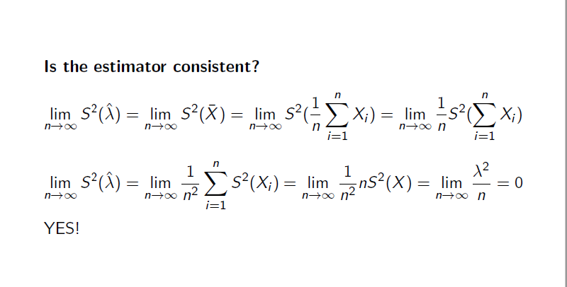

Slide 37
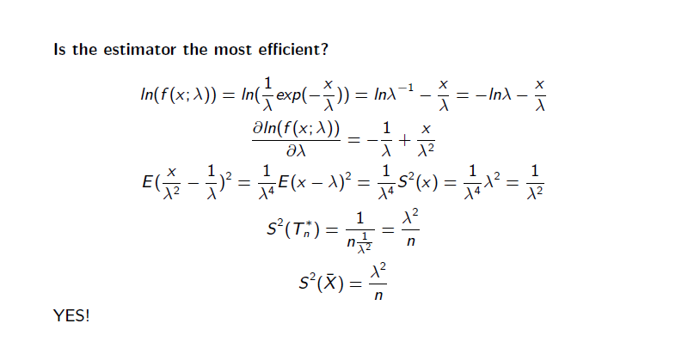

Slide 38
What is Confidence Interval?
A confidence interval is an estimate of an interval in statistics that may contain a population parameter. The unknown population parameter is found through a sample parameter calculated from the sampled data. For example, the population mean μ is found using the sample mean x̅.
The interval is generally defined by its lower and upper bounds. The confidence interval is expressed as a percentage (the most frequently quoted percentages are 90%, 95%, and 99%). The percentage reflects the confidence level.
The concept of the confidence interval is very important in statistics (hypothesis testing) since it is used as a measure of uncertainty. The concept was introduced by Polish mathematician and statistician, Jerzy Neyman in 1937.

Slide 39
Confidence Interval
We can also quantify the uncertainty (sampling distribution) of our
point estimate.
One way of doing this is by constructing an interval that is likely to
contain the population parameter.
One such an interval, which is computed on the basis of the data, is
called a confidence interval.
The sampling probability that the confidence interval will indeed
contain the parameter value is called the confidence level.
We construct confidence intervals for a given confidence level.

Slide 40
Interpretation of Confidence Interval
The proper interpretation of a confidence interval is probably the most challenging aspect of this statistical concept. One example of the most common interpretation of the concept is the following:
There is a 95% probability that, in the future, the true value of the population parameter (e.g., mean) will fall within X [lower bound] and Y [upper bound] interval.
In addition, we may interpret the confidence interval using the statement below:
We are 95% confident that the interval between X [lower bound] and Y [upper bound] contains the true value of the population parameter.
However, it would be inappropriate to state the following:
There is a 95% probability that the interval between X [lower bound] and Y [upper bound] contains the true value of the population parameter.

Slide 41
How to Calculate the Confidence Interval?
The interval is calculated using the following steps:
Gather the sample data.
Calculate the sample mean x̅.
Determine whether a population’s standard deviation is known or unknown.
If a population’s standard deviation is known, we can use a z-score for the corresponding confidence level.
If a population’s standard deviation is unknown, we can use a t-statistic for the corresponding confidence level.

Slide 42
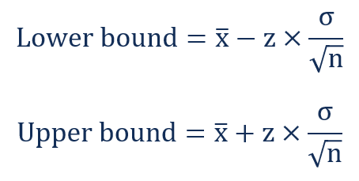
Find the lower and upper bounds of the confidence interval using the following formulas:
a. Known population standard deviation

Slide 43
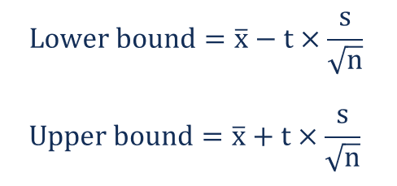
b. Unknown population standard deviation

Slide 44
Examples
Suppose we conduct a poll to try and get a sense of the outcome of an upcoming election with two candidates. We poll 1000 people, and 550 of them respond that they will vote for candidate A .
How confident can we be that a given person will cast their vote for candidate A?
Sol.
Select our desired levels of confidence We’re going to use the 90%, 95%, and 99% levels
Calculate α and α/2 Our α values are 0.1, 0.05, and 0.01 respectively Our α/2 values are 0.05, 0.025, and 0.005
Look up the corresponding z-scores Our Zα /2 values are 1.645, 1.96, and 2.58
Multiply the z-score by the standard error to find the margin of error
First we need to calculate the standard error

Slide 45
5. Find the interval by adding and subtracting this product from the mean.
In this case, we are working with a distribution we have not previously discussed, a normal binomial distribution (i.e. a vote can choose Candidate A or B, a binomial function).
We have a probability estimator from our sample, where the probability of an individual in our sample voting for candidate A was found to be 550/1000 or 0.55.
We can use this information in a formula to estimate the standard error for such a distribution:
5. Multiply the z-score by the standard error cont.
• For a normal binominal distribution, the standard error can be estimated using:
S.E= 0.0157

Slide 46
• We can now multiply this value by the z-scores to calculate the margins of error for each conf. level
Multiply the z-score by the standard error cont.
• We calculate the margin of error and add and subtract that value from the mean (0.55 in this case) to find the bounds of our confidence intervals at each level of confidence:
CI Zα/2 Margin of error Lower Bounds Upper Bounds
90% 1.645 0.026 0.524 0.576
95% 1.96 0.031 0.519 0.581
99% 2.58 0.041 0.509 0.591

Slide 47
What is Hypothesis Testing?
Hypothesis Testing is a method of statistical inference. It is used to test if a statement regarding a population parameter is statistically significant. Hypothesis testing is a powerful tool for testing the power of predictions.
For example: A Statistician might want to make a prediction of the mean value a customer would pay for his firm’s product. He can then formulate a hypothesis, for example, “The average value that customers will pay for my product is larger than $5”. To statistically test this question, the firm owner could use hypothesis testing.

Slide 48
Hypothesis testing is formulated in terms of two hypothesis:
H0: the null hypothesis;
H1: the alternate hypothesis.
The hypothesis we want to test is if H1 is “likely" true.
So, there are two possible outcomes:
Reject H0 and accept H1 because of sufficient evidence in the sample in favor or H1;
Do not reject H0 because of insufficient evidence to support H1.

Slide 49
Null Hypothesis and Alternative Hypothesis
Null Hypothesis
Alternative Hypothesis
The Null Hypothesis is usually set as what we don’t want to be true. It is the hypothesis to be tested. Therefore, the Null Hypothesis is considered to be true, until we have sufficient evidence to reject it. If we reject the null hypothesis, we are led to the alternative hypothesis.
Example of the business owner who is looking for some customer insight. His null hypothesis would be:
H₀ : The average value customers are willing to pay for my product is smaller than or equal to $5 or H₀ : µ ≤ 5(µ = the population mean)
The alternative hypothesis would then be what we are evaluating, so, in this case, it would be:
H_{a} : The average value customers are willing to pay for the product is greater than $5 or H_{a} : µ > 5

Slide 50
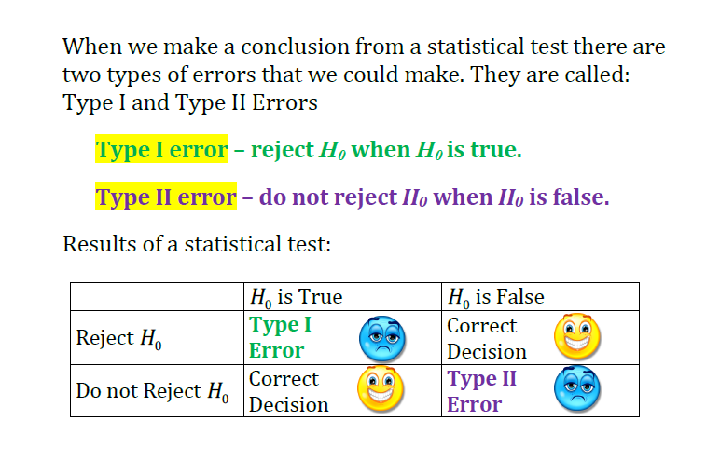

Slide 51
Type I and Type II Errors
A Type I Error arises when a true Null Hypothesis is rejected. The probability of making a Type I Error is also known as the level of significance of the test, which is commonly referred to as alpha (α). So, for example, if a test that has its alpha set as 0.01, there is a 1% probability of rejecting a true null hypothesis or a 1% probability of making a Type I Error.
A Type II Error arises when you fail to reject a False Null Hypothesis. The probability of making a Type II Error is commonly denoted by the Greek letter beta (β). β is used to define the Power of a Test, which is the probability of correctly rejecting a false null hypothesis.

Slide 52
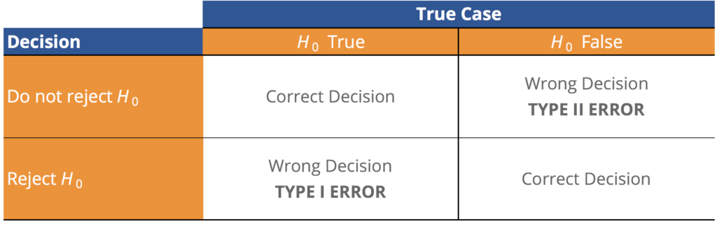
The Power of a Test is defined as 1-β. A test with more Power is more desirable, as there is a lower probability of making a Type II Error. However, there is a tradeoff between the probability of making a Type I Error and the probability of making a Type II Error.

Slide 53
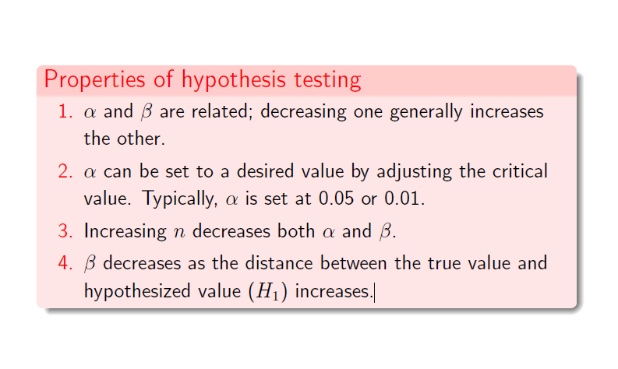
Properties of hypothesis testing

Slide 54
Significance level - is the maximum probability of committing a Type I error. This probability is symbolized by α.
P(Type I error|H0 is true)=α.
Critical or Rejection Region – the range of values for the test value that indicate a significant difference and that the null hypothesis should be rejected.
Non-critical or Non-rejection Region – the range of values for the test value that indicates that the difference was probably due to chance and that the null hypothesis should not be rejected.

Slide 55
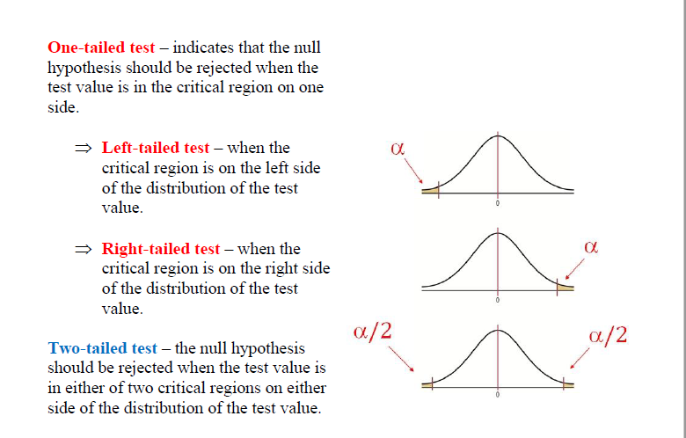

Slide 56
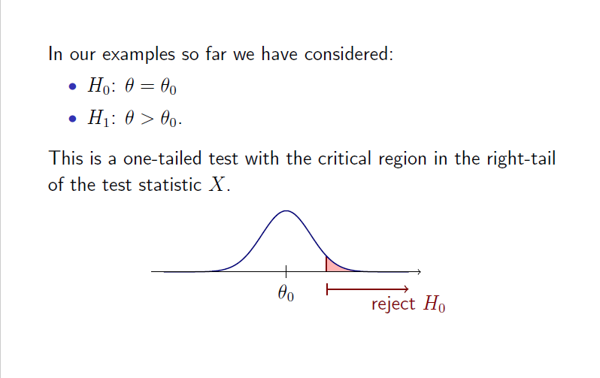
One tail test(Right tail)

Slide 57
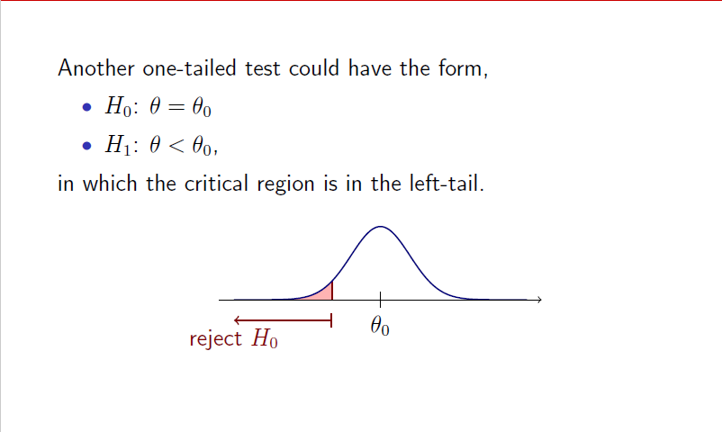
Left-tail test

Slide 58
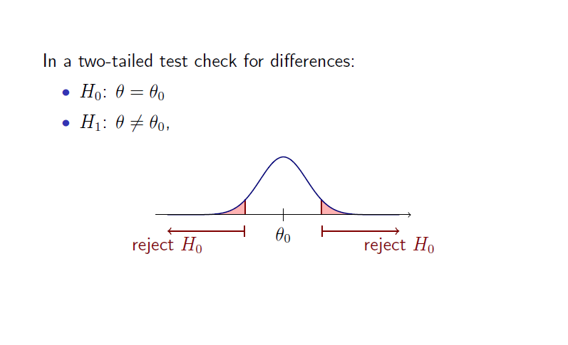
Two-tail test

Slide 59
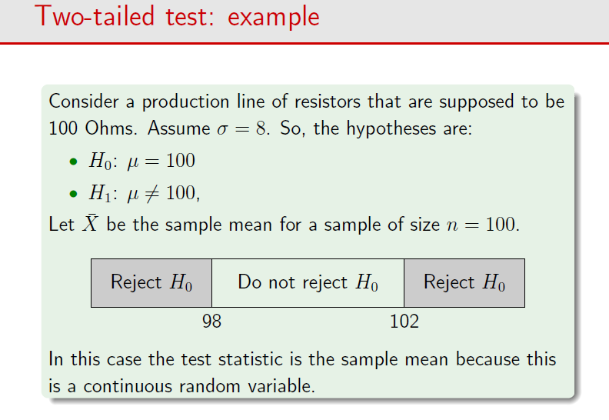

Slide 60
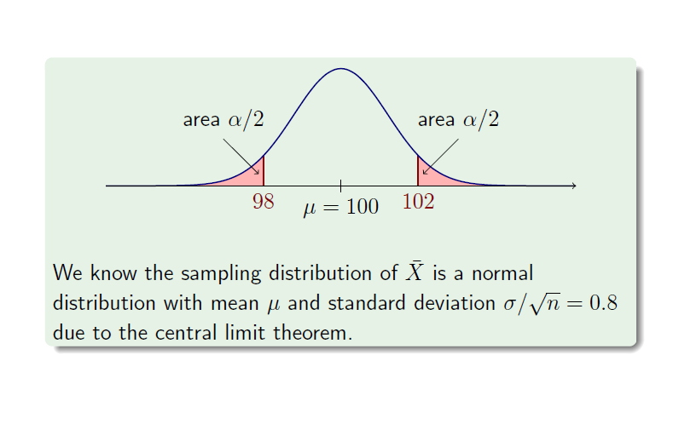

Slide 61
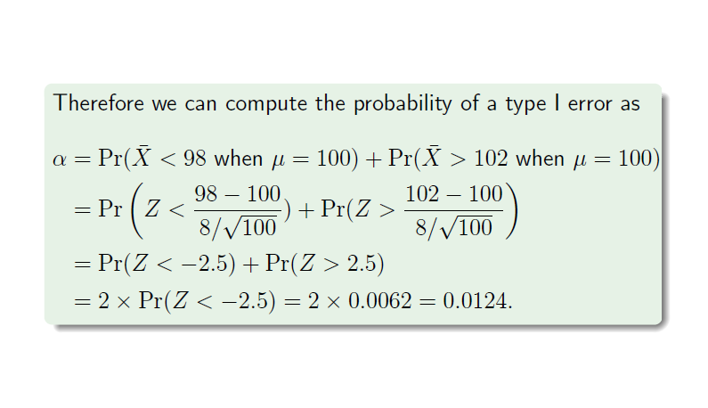

Slide 62
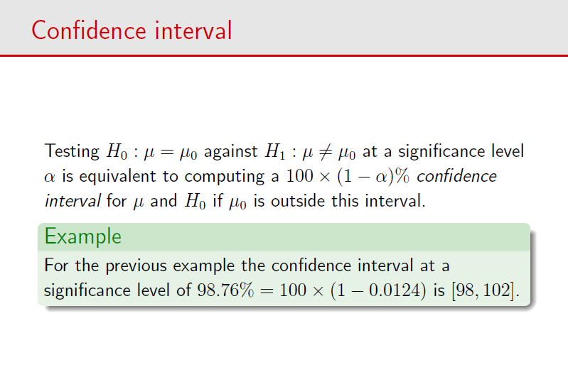

Slide 63
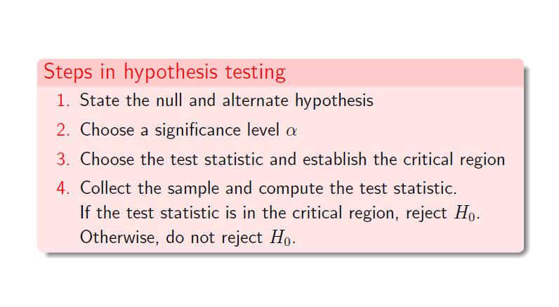
Steps in hypothesis testing

Slide 64
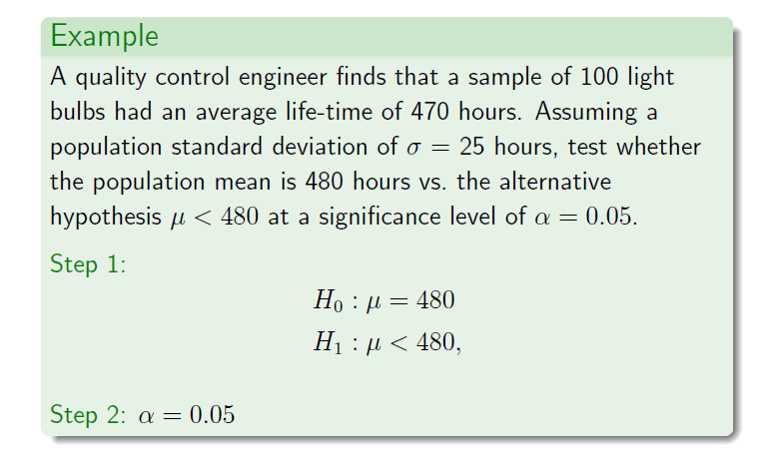

Slide 65
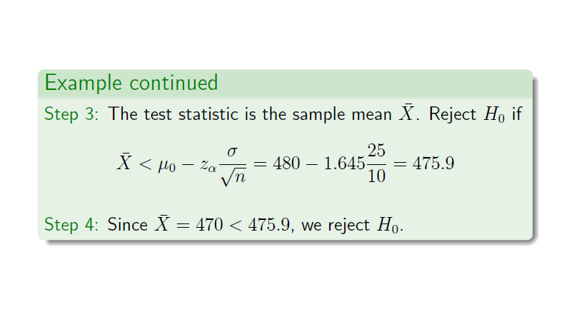

Slide 66
Testing a hypothesis about the mean of a population
We have the following steps:
1.Data: determine variable, sample size (n), sample mean( ) , population standard deviation or sample standard deviation (s) if is unknown
2. Assumptions : We have two cases:
Case1: Population is normally or approximately normally distributed with known or unknown variance (sample size n may be small or large),
Case 2: Population is not normal with known or unknown variance (n is large i.e. n≥30).

Slide 67
3.Hypothesis: we have three cases
Case I : H0: μ=μ0 Vs HA: μ μ0
e.g. we want to test that the population mean is different than 50
Case II : H0: μ = μ0 Vs HA: μ > μ0
e.g. we want to test that the population mean is greater than 50
Case III : H0: μ = μ0 Vs HA: μ< μ0
e.g. we want to test that the population mean is less than 50

Slide 68
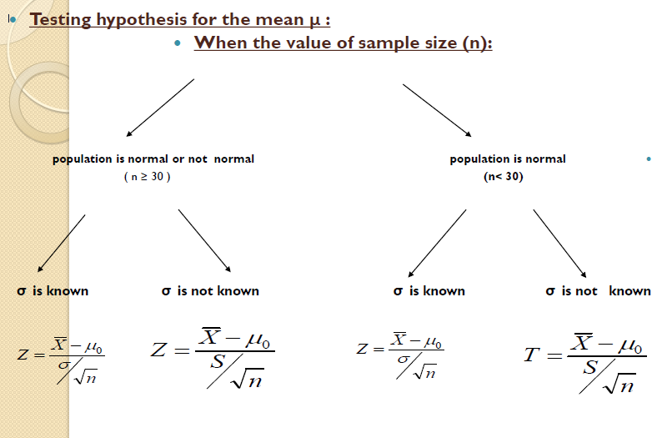

Slide 69
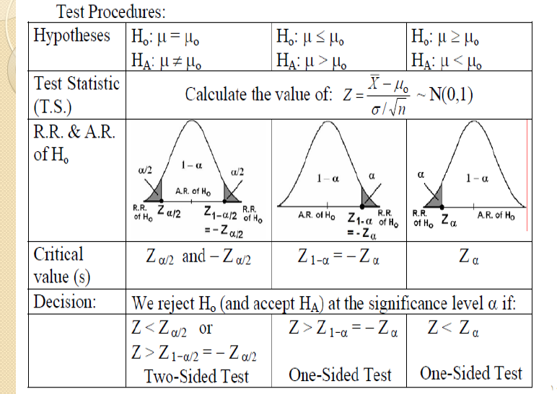

Slide 70
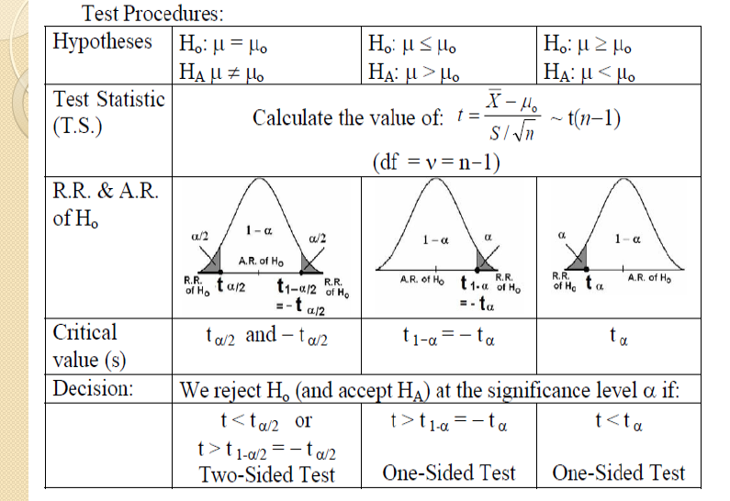

Slide 71
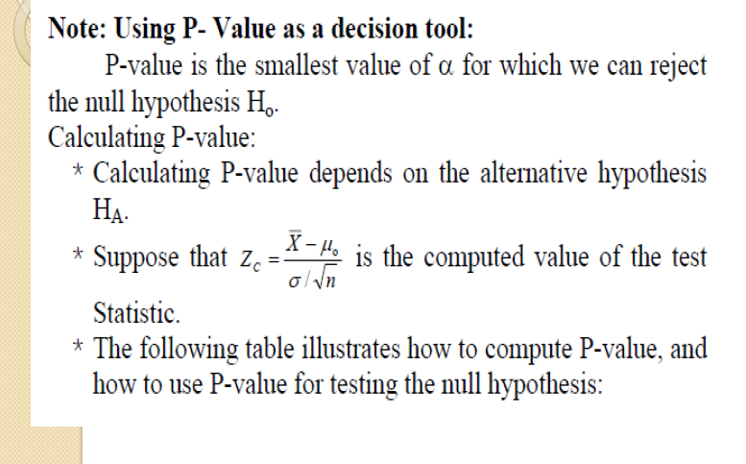

Slide 72
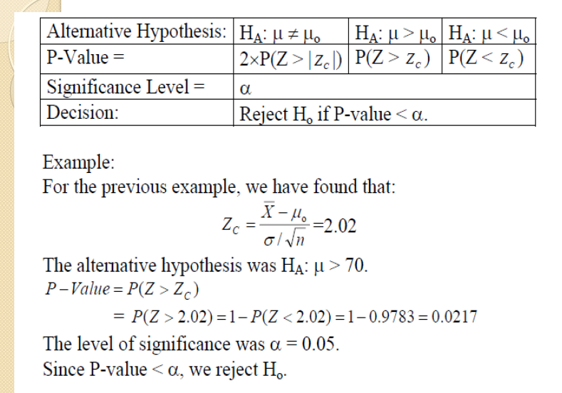

Slide 73
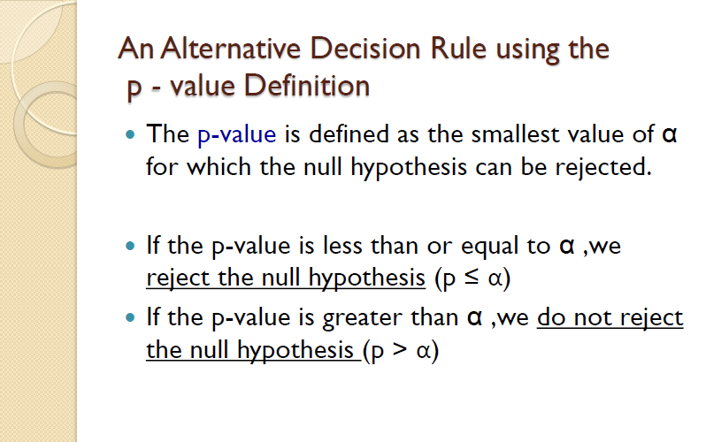

Slide 74
Example
Researchers are interested in the mean age of a certain population.
A random sample of 10 individuals drawn from the population of interest has a mean of 27.
Assuming that the population is approximately normally distributed with variance 20,can we conclude that the mean is different from 30 years ? (α=0.05) .
If the p - value is 0.0340 how can we use it in making a decision?

Slide 75
Solution
1-Data: variable is age, n=10, =27 ,σ2=20,α=0.05
2-Assumptions: the population is approximately normally distributed with variance 20
3-Hypotheses:
H0 : μ=30
HA: μ 30
4-Test Statistic:
Z = -2.12
5.Decision Rule
The alternative hypothesis is HA: μ ≠ 30
Hence we reject H0 if Z > Z(1-0.025)= Z(0.975)
or Z< - Z(1-0.025 )= - Z(0.975)
Z(0.975)=1.96(from table D)

Slide 76
6.Decision:
We reject H0 ,since -2.12 is in the rejection region .
We can conclude that μ is not equal to 30
Using the p value ,we note that p-value =0.0340< 0.05,therefore we reject H0

Slide 77
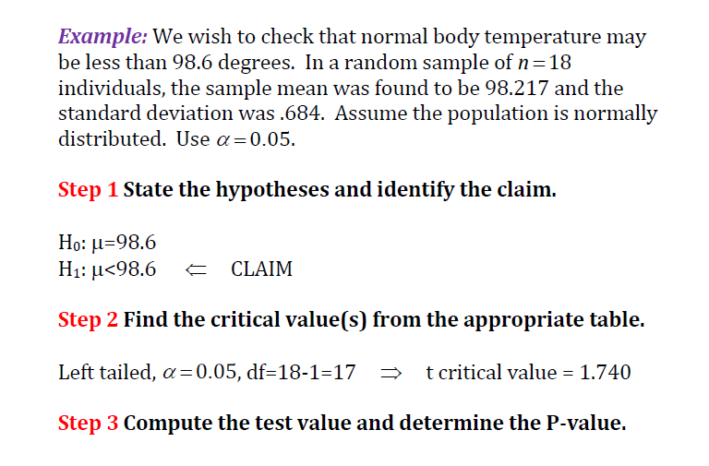

Slide 78
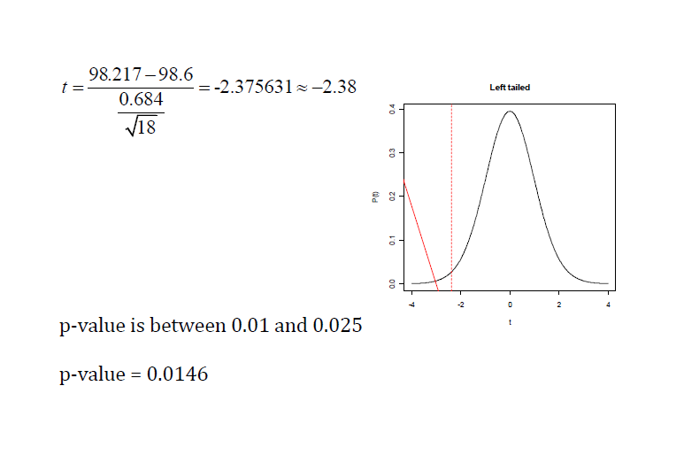

Slide 79


Slide 80
Thankyou

